Slide 1
Student Centered Learning: A Practical Guide
Gwendolyn Gillson
University of Iowa

Slide 3
Overview
What is student centered learning?
Where to begin
Maryellen Weimer’s 5 changes
Challenges
Issues particular to religious studies/religion

Slide 4
What is Student-Centered Learning?
Learner centered teaching means subjecting every teaching activity (method, assignment or assessment) to the test of a single question: “Given the context of my students, course and classroom, will this teaching action optimize my students’ opportunity to learn?”
(Terry Doyle, https://learnercenteredteaching.wordpress.com/learner-centered-teaching-resources/definition-of-learner-centered-teaching/ )

Slide 5
Other similar terms
Learner-Centered Teaching
Personalized Learning/personalization
Collaborative Learning
Active Learning
Inquiry-based Learning
Cooperative Learning
Problem-based Learning
Peer Led Team Learning
Team-based Learning
Peer Instruction
Inquiry Guided Learning
Just-in-Time Teaching
Small Group Learning
Project-based Learning
Question-directed Instruction

Slide 6
Supporting Research
Higher test scores (Bryan K. Saville et al. 2006)
Better class grades, especially for diverse populations (Ralph W. Preszler 2009)
Students’ understanding of how to obtain knowledge and skills transformed, especially women (Sharon Stoerger and Denise Krieger 2016)
Notes:
Saville et al - grad class in special ed and undergrad research methods course with focus on interteaching which is selected parts of SCL (like group work and self-paced work)
Preszler – 10 semesters worth of intro biology – replaced one lecture w/ peer workshops; students scored higher on higher-level courses
Stoerger and Krieger – Information Technology Course – added online collaborative work on a wiki and infographic project, interviews were generally positive and grades went up over time

Slide 7
Theoretical Background
Attribution theory
Self-efficacy
Radical and critical pedagogy
Feminist pedagogy
Constructivism
Transformative learning

Slide 8
Questions to Ask Yourself
In what ways do students feel respected, feel valued, and feel part of the whole group?
In what ways do students have ownership of the classroom? Do they ever make decisions about resources, environment, or use of time? When? How often?
Do they have ownership in their learning? Do they have choices and options for projects, assignments, and partners for group work?
When are students comfortable with expressing who they are and their thoughts and ideas? When are they not?
When do you inquire about the needs of your students? How often do you do this? How often do you check for group understanding and adjust the instruction accordingly?
How are desks arranged? Are students facing each other? Do they have multiple opportunities each week to share with fellow classmates, and to share with a variety of classmates?
As the instructor, what is my "air time" each class session? How much direct instruction is there? How might I change some of that directing teaching to facilitating?
(Rebecca Alber - https://www.edutopia.org/blog/how-student-centered-your-classroom-rebecca-alber)

Slide 9
Weimer’s 5 Changes to Practice

Slide 10
The Role of the Teacher

Slide 11
The Balance of Power

Slide 12
The Function of Content

Slide 13
The Responsibility for Learning

Slide 14
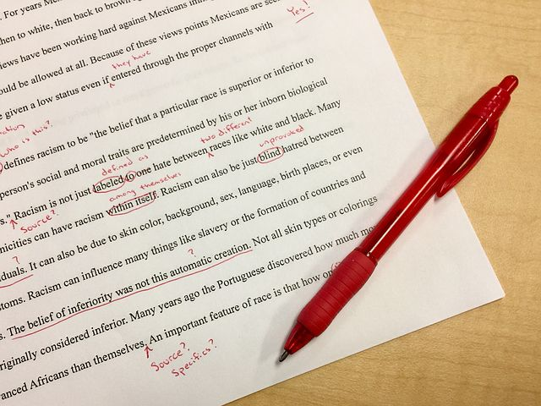
The Purpose and Process of Evaluation

Slide 15
Resistance
Old Habits Die Hard
High schools remain teacher-centered
Learning is not a top priority
Students don’t like taking learning risks
Doesn’t look like “school”
Don’t want to invest effort
Mindsets about learning make adapting to SLC difficult
Path of least resistance
As identified by Terry Doyle in Helping Students Learn in a Learner Centered Environment

Slide 16
Religious Studies and SCL

Slide 17
A few cautions

Slide 18
So what can I do now?

Slide 20
References
Abler, Rebecca. “How Student Centered is Your Classroom?” Edutopia. January 29, 2015; Updated August 17, 2015. Accessed June 7, 2017. https://www.edutopia.org/blog/how-student-centered-your-classroom-rebecca-alber.
Doyle, Terry. “Definition of Learner Centered Teaching.” Learner Centered Teaching: Largest Resource for Learner Centered Teaching on the Web. Blog entry. https://learnercenteredteaching.wordpress.com/learner-centered-teaching-resources/definition-of-learner-centered-teaching/.
Doyle, Terry. Helping Students Learn in a Learner-Centered Environment: A Guide to Facilitating Learning in Higher Education. Sterling, VA: Stylus, 2008.
Goza, Barbara K. “Graffiti Needs Assessment: Involving Students in the First Class Session.” Journal of Management Education 17, no. 1 (1993): 99-106.
Preszler, Ralph W. “Replacing Lecture with Peer-Led Workshops Improves Student Learning.” CBE Life Sciences Education 8 (2009): 182–192.
Saville, Bryan K. et al. “A Comparison of Interteaching and Lecture in the College Classroom.” Journal of Applied Behavior Analysis 39 (2006): 49–61.
Stoerger, Sharon, and Denise Krieger, “Transforming a Large-Lecture Course into and Active, Engaged, and Collaborative Learning Environment,” Education for Information 32 (2016): 11-26.
Weimer, Maryellen. Learner-Centered Teaching: Five Key Changes to Practice. Second Edition. San Francisco: Jossey-Bass, 2013.

